Slide 1
Can You Hear
Me Now?
#PRNews | SukhiSahni

Slide 2
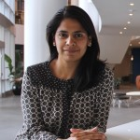
About Myself
STORYTELLER AT HEART
Integrated Communications Strategist
Trained Journalist
Build and Cultivate Relationships
#PRNews | SukhiSahni

Slide 3
The media landscape has fundamentally shifted
1985
2017
Shift from one-way, to two-way, to co-creation
Most Americans today get at least some of their news on social media
#PRNews | SukhiSahni
Notes:
Two decades ago, 43% of Americans got their news from traditional outlets
According to a 2017 Pew Study, 67% of Americans get at least some of their news on social media
20 years ago, consumers received 600 messages a day vs. 5,000 today
More Americans now get news on multiple social media sites. However, many social media news consumers still get news from more traditional platforms

Slide 4
Impacting how people
consume news
NEW MODEL
Authority & Influence
Influence
Authority
OLD MODEL
Traditional earned media funnel has been up-ended
#PRNews | SukhiSahni
Notes:
Traditional earned media funnel has been up-ended.
Influence now sits in the general population and often migrates into mainstream news
Relevant, relatable content that sparks a conversation is key to success

Slide 5
Making modern journalism a
multi-platform discipline
EARNED
Traditional Broadcast, Radio, Print, Bylined, Op-Eds, Data, Reviews, Awards
OWNED
Digital Branded Content, Blogs, Websites, Emails
Media
Consumers
PAID
Podcasts, Radio, SEO, Display Ads, Search Ads, Native Advertising, Media Integrations
SHARED
Social Channels, Influencers, Forums, Groups, Message Boards
Major media outlets are looking for stories that transcend one channel & adapt to multiple platforms
#PRNews | SukhiSahni

Slide 6
Resulting in evolution of the
press release
MULTIPLE PLATFORM
Newsroom post
Branded blog
Tweet
Influencer Partnership
Facebook Live
Content Partnership
SINGLE PLATFORM
Press Release
Press Releases should be a critical part of the omni-channel marketing mix
#PRNews | SukhiSahni

Slide 7
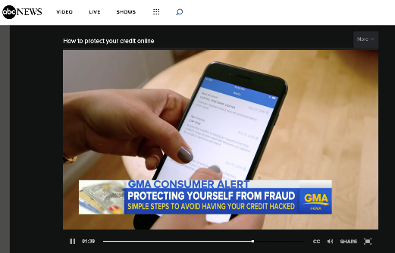
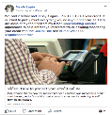
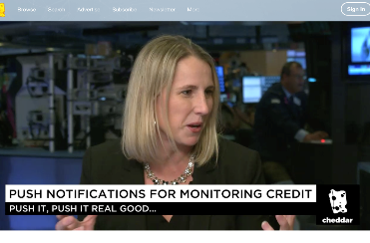
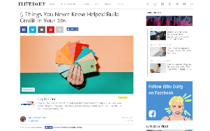
Case Study Newsroom Post | Branded Broadcast Integration | Unique Original Content | Original Research | Podcasts | Earned Broadcast Interviews | Experiential Events
#PRNews | SukhiSahni

Slide 8
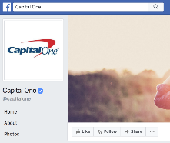
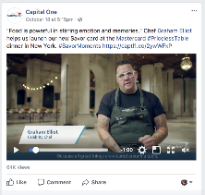
Case Study Influencers | Newsroom Post | Celebrity Chefs | Unique Original Content | Original Research | Podcasts | Media Interviews | Experiential Events
#PRNews | SukhiSahni
Notes:
https://www.facebook.com/capitalone/videos/1422166344497504/

Slide 9
Checklist
Tell a story. Content is KING.
Be creative with your headlines.
No canned quotes, please.
Think visual.
Imbed links and drive action.
Embrace co-creation.
#PRNews | SukhiSahni
Notes:
﻿At the end of the day, its what you share that will determine the success of your release.
Make your headlines catchy and interesting. Usually 120 words or less. Have a sub-headline and build keywords into the headline. If it’s a blog and you end up amplifying it with Outbrain, you can even test different headlines and the consumer behavior with it.
Make your quotes relatable. Not the usual. Rather have an influencer or an associate or someone less branded give credibility to your quote. We used a card expert when we launched a big campaign few years ago. He was asked for multiple interviews just based on his quote that was included in the release.
Visuals always help. People have small memories so visuals and that too good ones tend to stick around. Instead of a blog do a visual story board especially if you are sharing research.
PR in whichever format is a great way to drive traffic to a specific destination. Imbed links throughout and if necessary a CTA. Again depends on your industry andhow heavily regulated it is…e.g. at Capital One we cant say “go apply for the card” but we usually include a link with a CTA to see how many rewards could you earn to your next vacation?
“Embrace Co-Creation” --- again where either the consumer directly or a third party (influencer) is co-creating the brand message; that it’s less omnidirectional to reflect how the landscape has changed.

